Slide 1
NIDDM a cycle of care
And
How (not) to COC it up completely!

Slide 2
What’s in a Cycle of Care
‘A step towards comprehensive NIDDM care’
2 Visits
ANNUAL VISIT 1
LIFESTYLE REVIEW (Smoking, Alcohol, Weight, Exercise) MEDs REVIEW IMMUNISATION Check BMI, BP, FEET REFER
(Eyes, Education) HBA1C,LIPID,UE,ACR
ANNUAL VISIT 2
LIFESTYLE REVIEW (Smoking, Alcohol, Weight, Exercise) MEDs REVIEW IMMUNISATION Check BMI, BP, FEET REFER
(Eyes, Education) HBA1C,LIPID,UE,ACR

Slide 3
What’s in a Cycle of Care
2 Data Returns REGISTRATION- GMS, Ethnicity and Duration of Illness
INITIAL or ANNUAL Full clinical data (end of Q1 in Year after registration or capitation)

Slide 4
Sounds pretty comprehensive to me!
How do you do it?
How can Health.one assist?

Slide 5
Finding
Registering
Consulting
Managing the cohort

Slide 6
FINDING 1: Find GMS patients with NIDDM
Database analysis

Slide 7
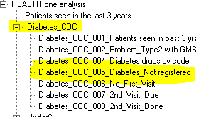
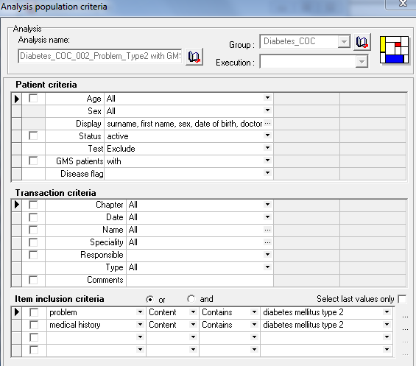
FINDING 2: Find GMS patients with NIDDM yet to be registered

Slide 8
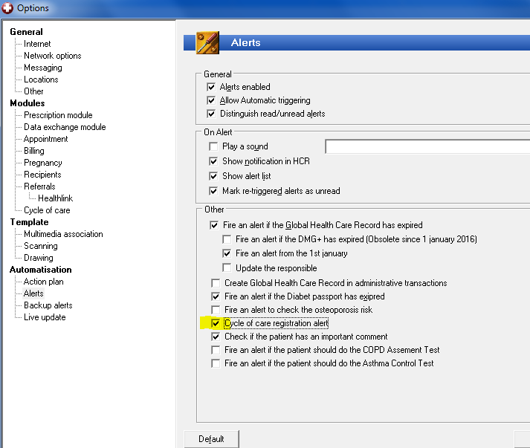
FINDING 2: Find GMS patients with NIDDM so an Alert can fire
Make sure COC Alerts are enabled (Tools\Options..)
Notes:
You can of course search and register En Bloc

Slide 9
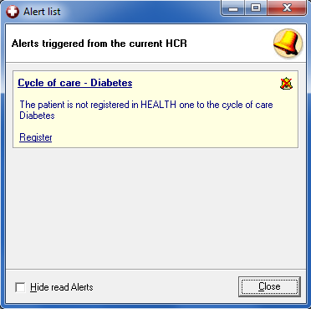
FINDING 2: Find GMS patients with NIDDM yet to be registered
Alert to Register GMS + NIDDM

Slide 10
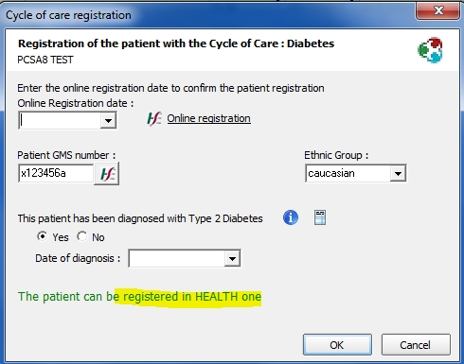
REGISTRATION 1
Registration in Health.one

Slide 11
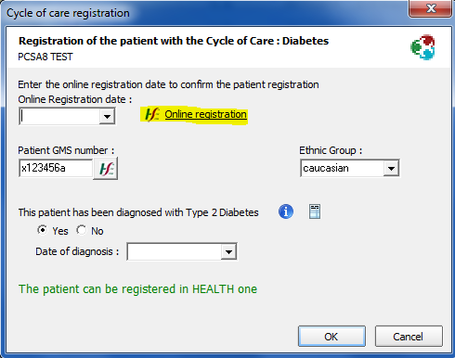
REGISTRATION 2
Registration at PCRS.

Slide 12
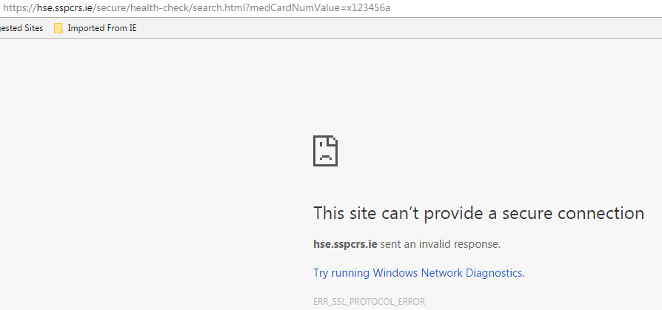
REGISTRATION 2
Registration at PCRS currently not possible from H1!

Slide 13
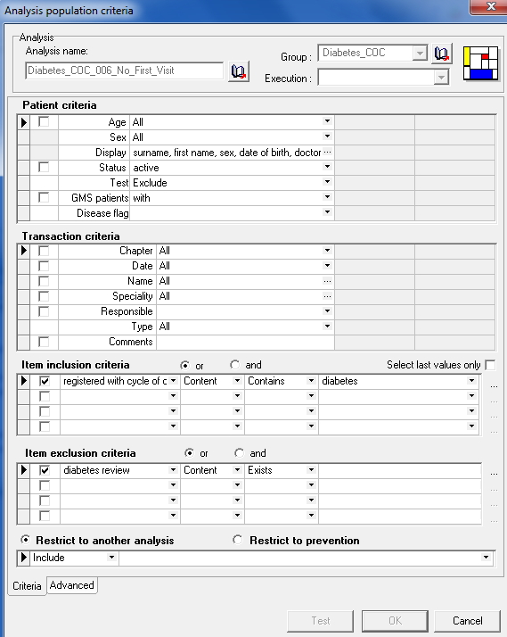
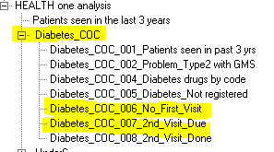
FINDING 3: Find COC patient with visit due.

Slide 14
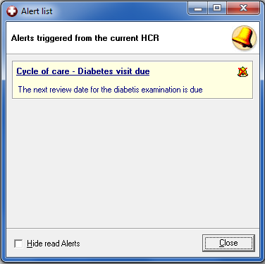
FINDING 3: Find COC patient with visit due.
Alert that COC visit is due (first or second)

Slide 15
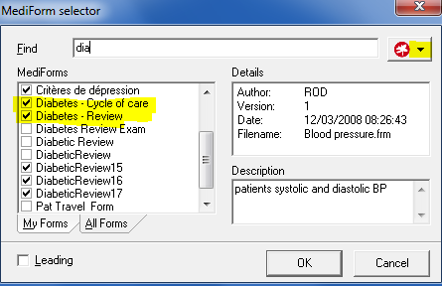
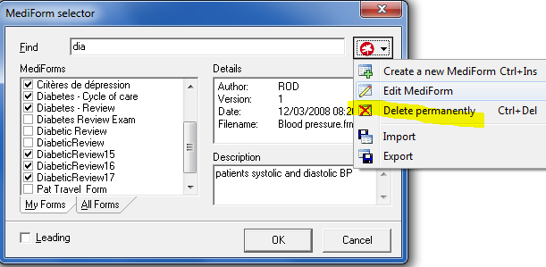
Consulting 1: Removing old Mediforms

Slide 16
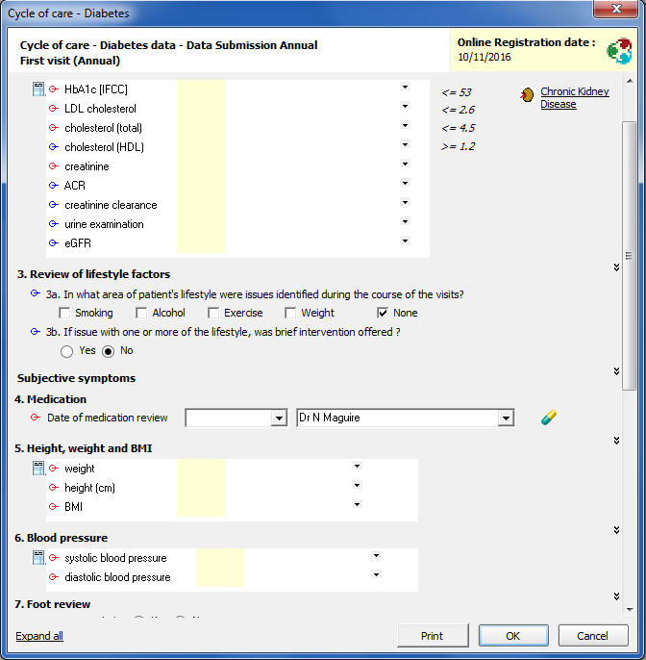
Consulting 2: Mediforms 1st visit. & 2nd visit

Slide 17
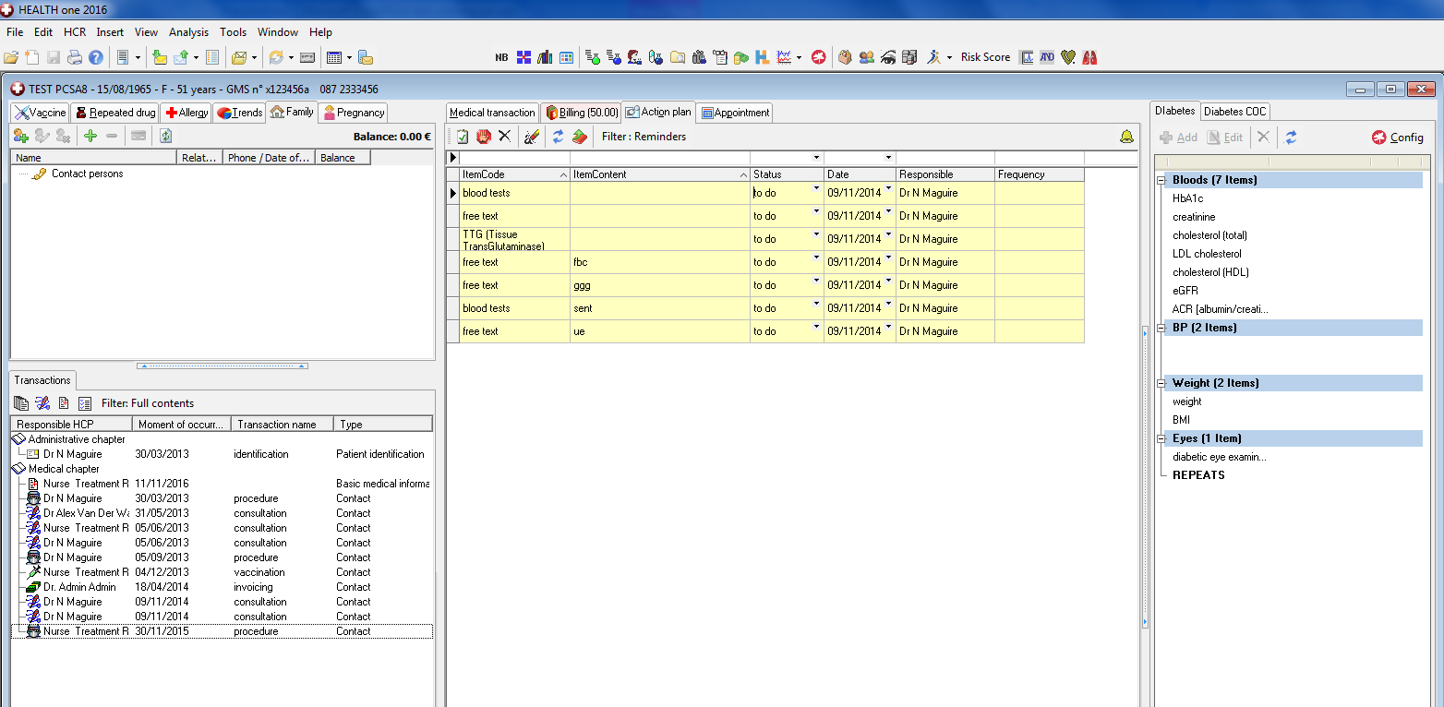
Consulting 3: Chronic disease side pane

Slide 18
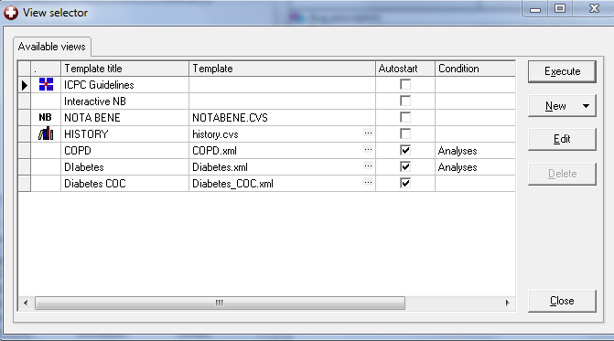
Consulting 3: Chronic disease side pane

Slide 19
Consulting 3: Chronic disease side pane- ”Pimp your Pane”

Slide 20
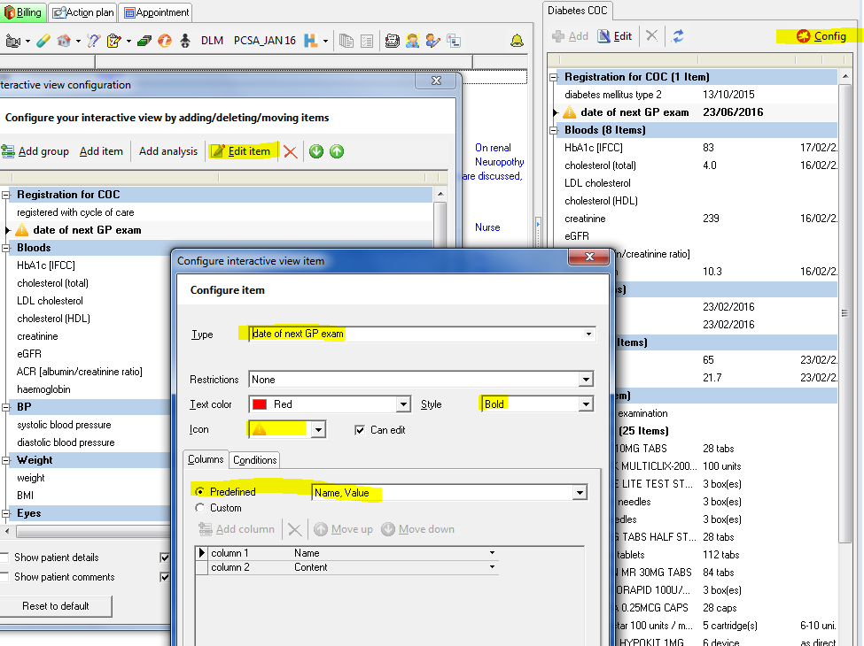

Slide 21
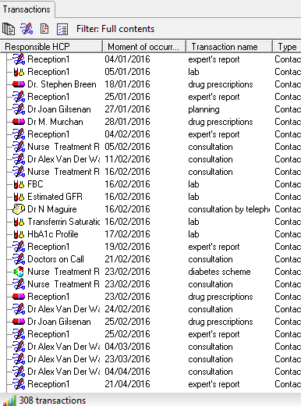
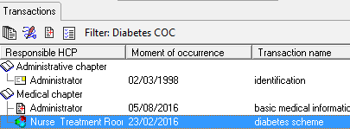
Consulting 4: Transaction filter Configuration

Slide 22
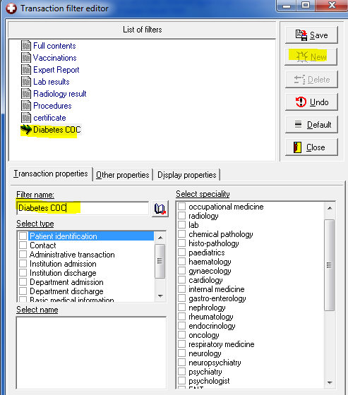
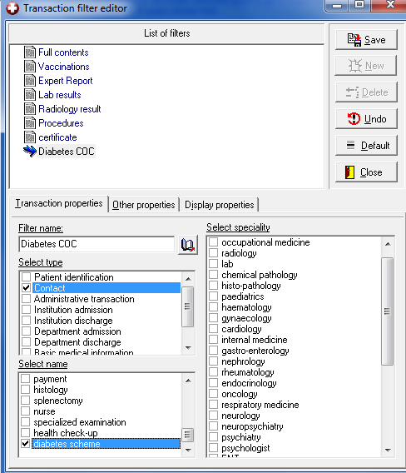
Consulting 4: Transaction filter Configuration
Notes:
R Click anywhere on transaction list select Filter Editor

Slide 23
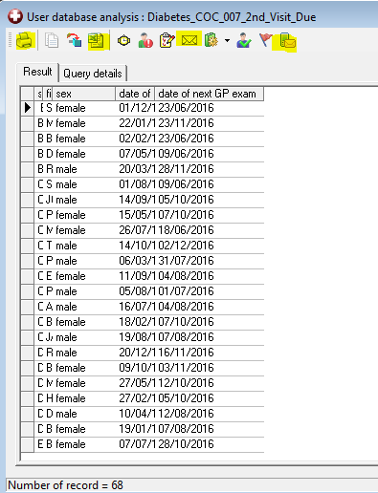
Managing 1: Call & Recall

Slide 24
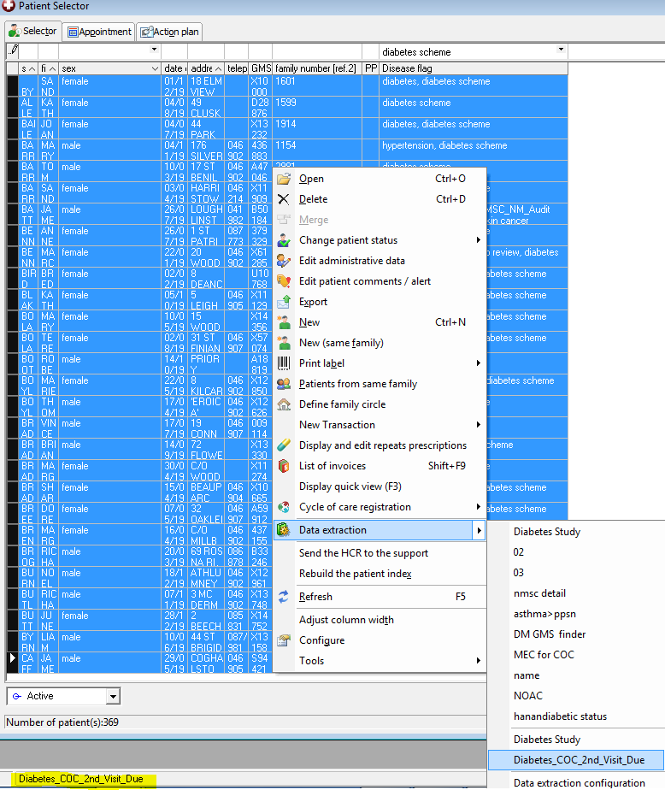
Managing 2: Data Extraction tool to provide spreadsheet for Overview

Slide 25
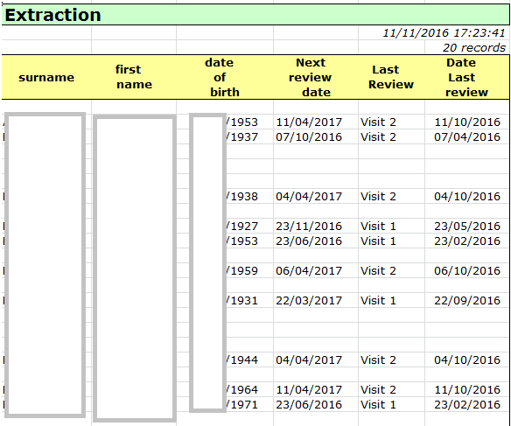
Managing 4: Data Extraction tool to provide spreadsheet for review

